Slide 1
ME751 Advanced Computational Multibody Dynamics
Newton-Euler Form of the EOM
(The r-p Formulation)
March 16, 2010
“If everything seems under control, you’re just not going fast enough.”
Mario Andretti, F1 Driver
© Dan Negrut, 2010 ME751, UW-Madison

Slide 2
Before we get started…
Last Time:
Learn how to obtain EOM for a 3D system: the r-! formulation
Today:
Learn how to obtain EOM for a 3D system: the r-p formulation
Super briefly talk about the EOM when using Euler Angles
Talk about HW
HW: number of grace days increased from two to four
Visualization discussion topic started on Forum
http://sbel.wisc.edu/Forum/index.php?topic=62.0
Has been updated over the weekend by Hammad
Final Project:
Feedback: http://sbel.wisc.edu/Courses/ME751/2010/Documents/FinalProjectRelated/finalProjectProposals.pdf
Thursday’s HW asks for final version of the proposal (some of you need to do nothing)

Slide 3
Midterm Exam
Scheduled at the beginning of the semester for April 22, in the evening
Original plan called for no class on April 22
Due to a change of schedule for visitors, the April 29 visitor will now show up on April 22
Visitor is in NVIDIA’s Research Group (Jonathan Cohen)
Talk about visualization, GPU computing, etc.
What does this mean?
We will have to push back the date of the midterm exam to April 29
I would like for the exam to be from 7:15 till 9:15 PM
If there are any conflicts please see me; I’ll try to accommodate you
There will be no class on April 29 to allow you some extra time to prepare for exam
Recall that midterm exam accounts for 20% of final grade

Slide 4
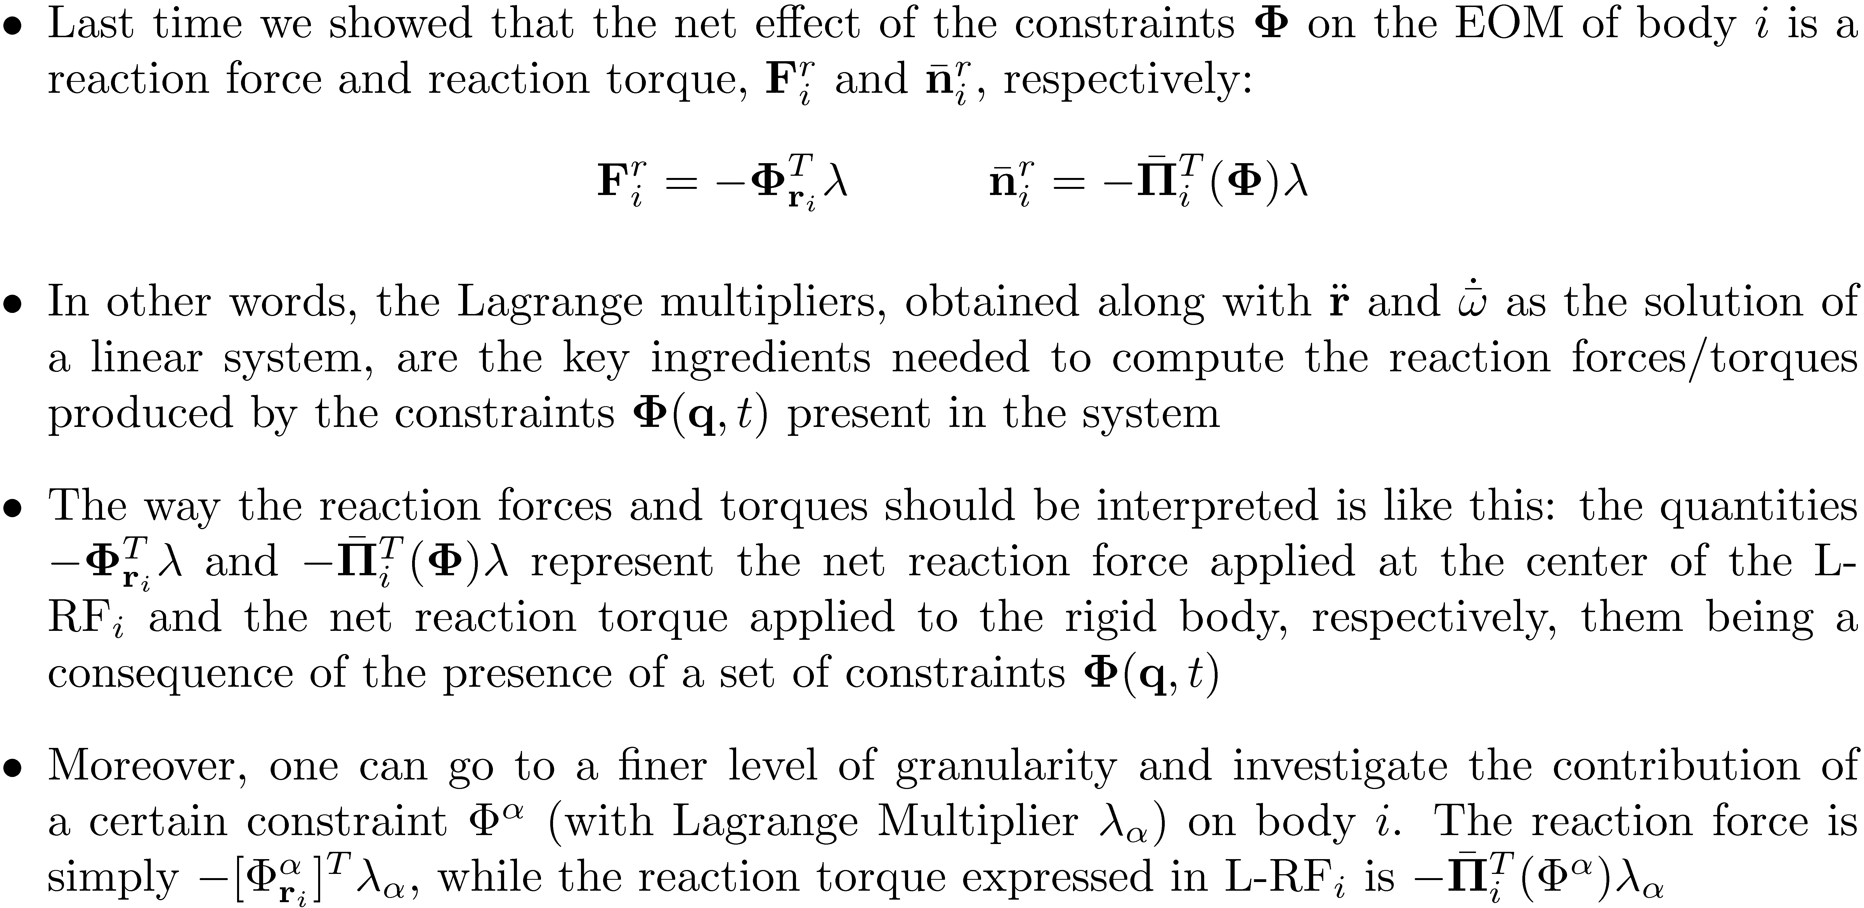
Recovering The Reaction Forces/Torques [from last time]

Slide 5
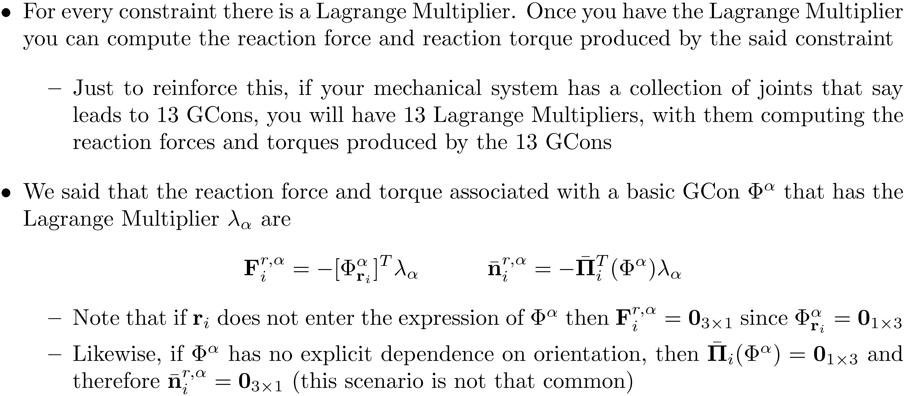
Comments on the Reaction Forces/Torques [from last time]

Slide 6
Deriving the EOM

Slide 7
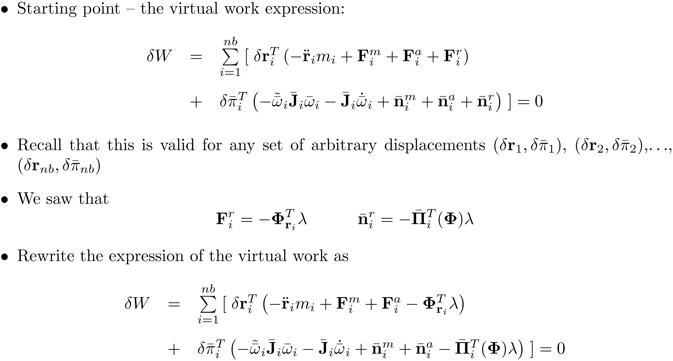
The r-p Formulation of the EOM

Slide 8
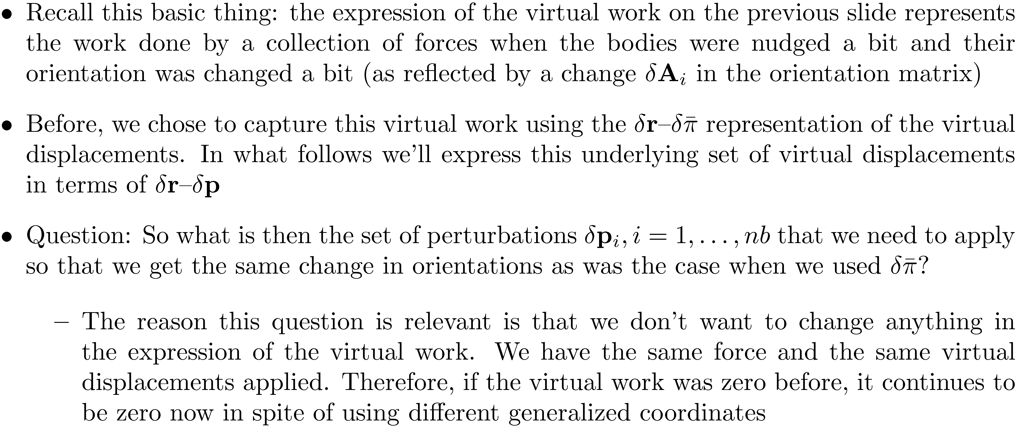
The r-p Formulation of the EOM: Quick Comments

Slide 9
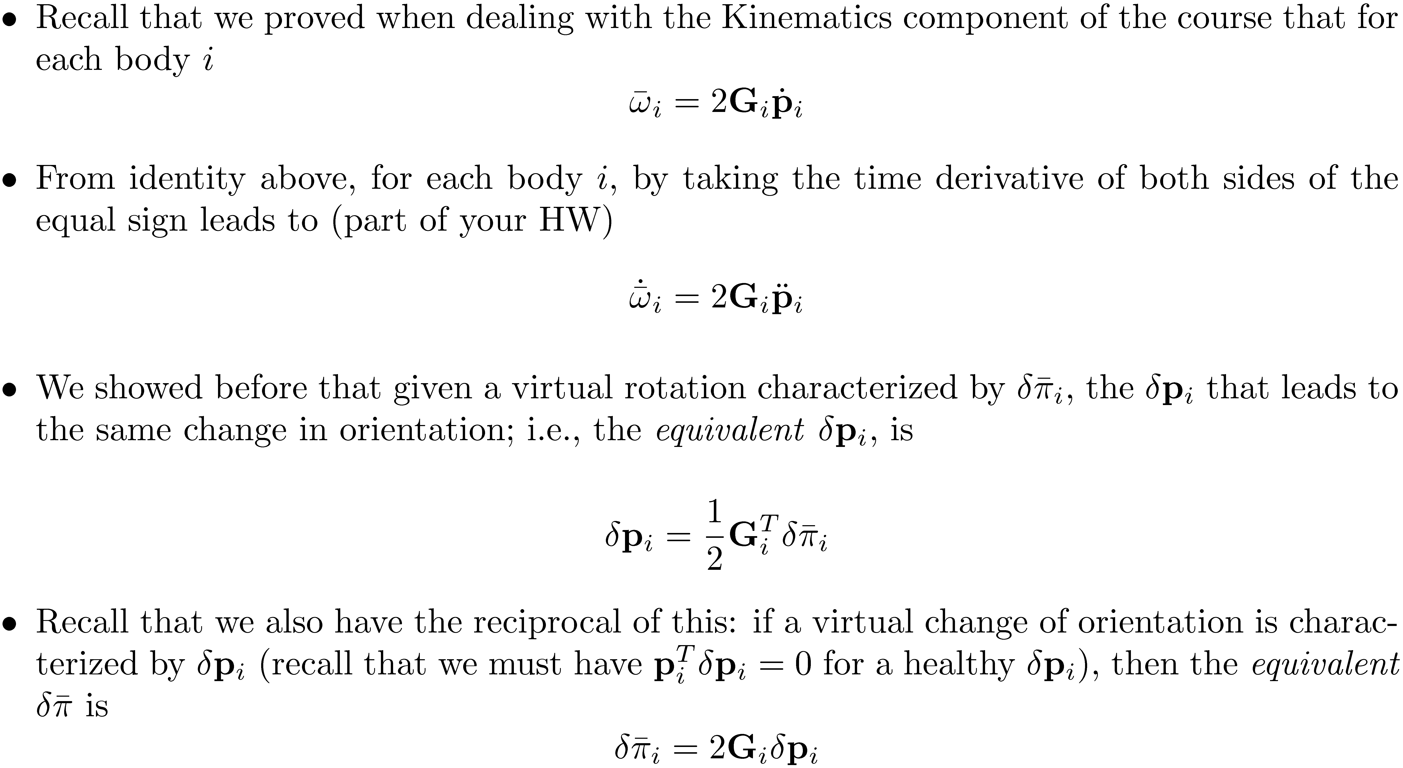
The r-p Formulation of the EOM: Useful Identities

Slide 10
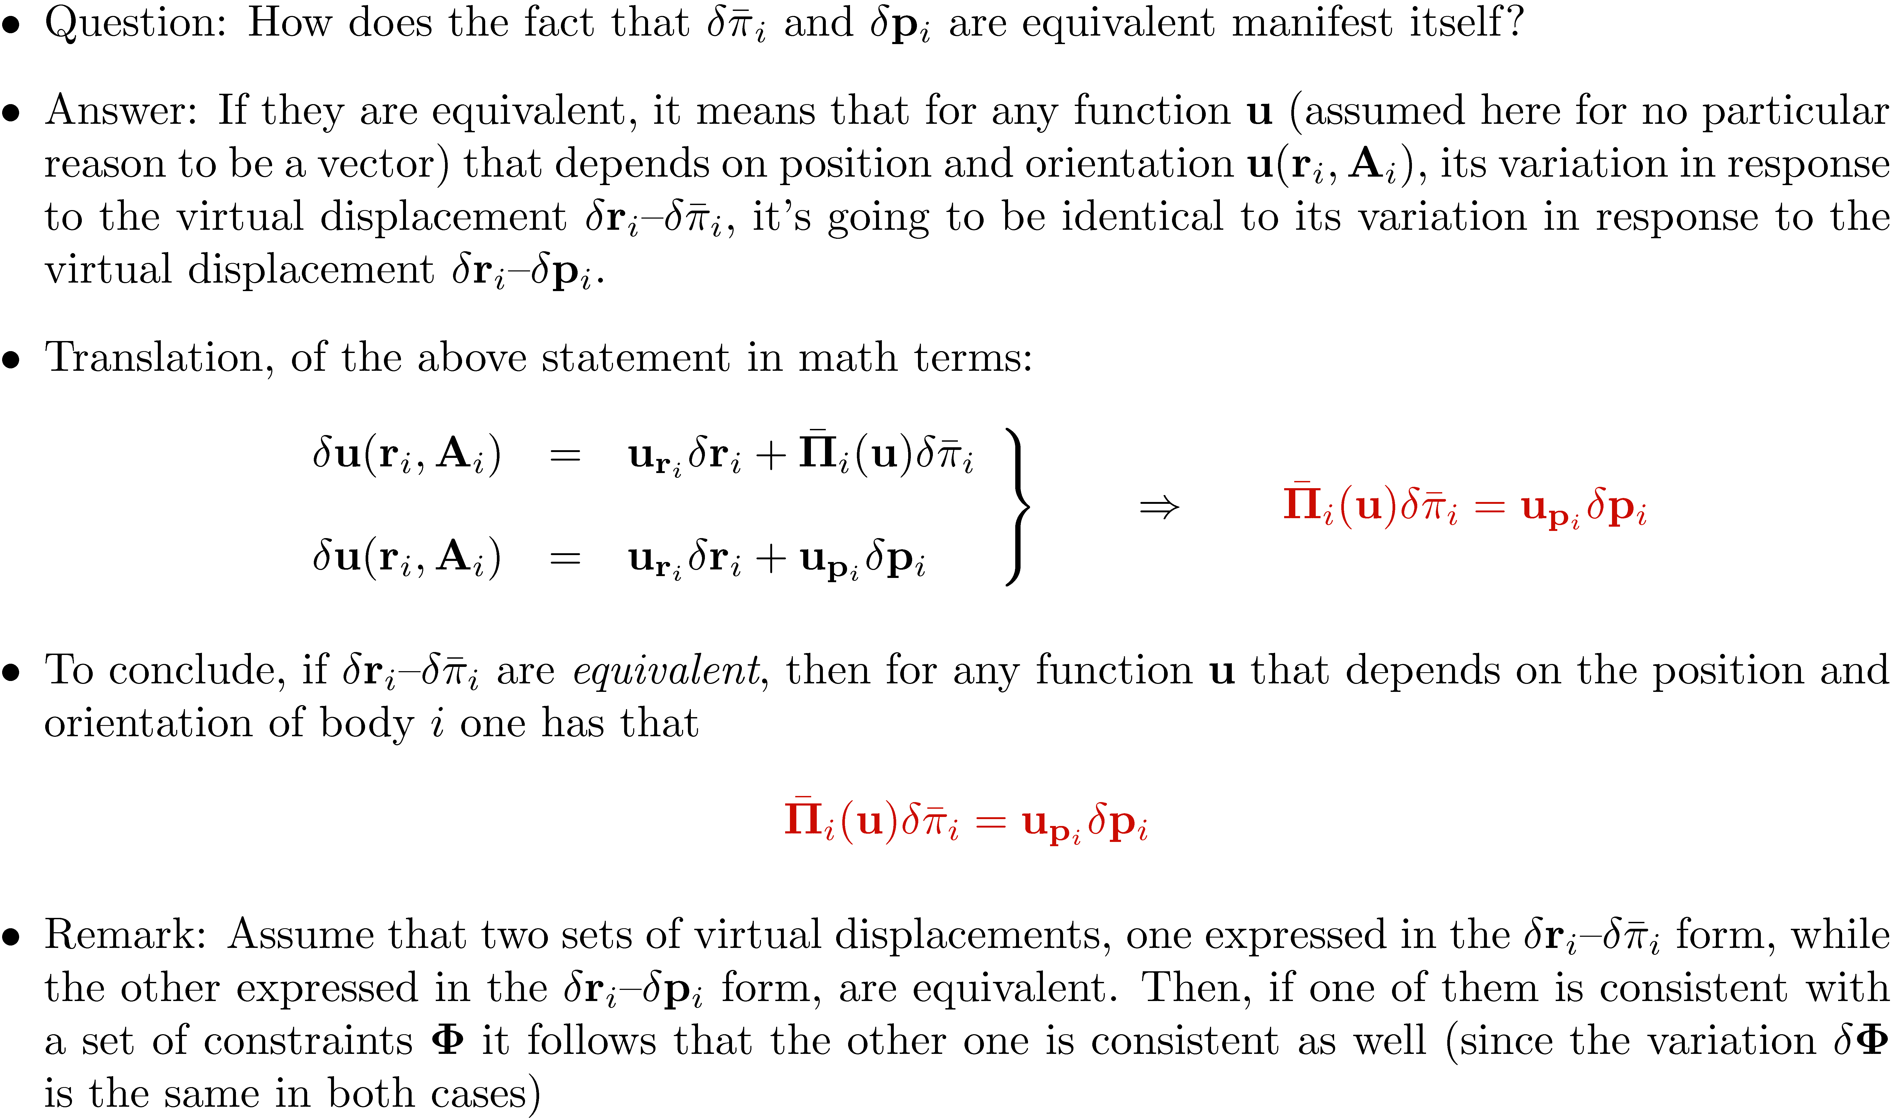
The r-p Formulation of the EOM: Equivalent Virtual Displacements

Slide 11
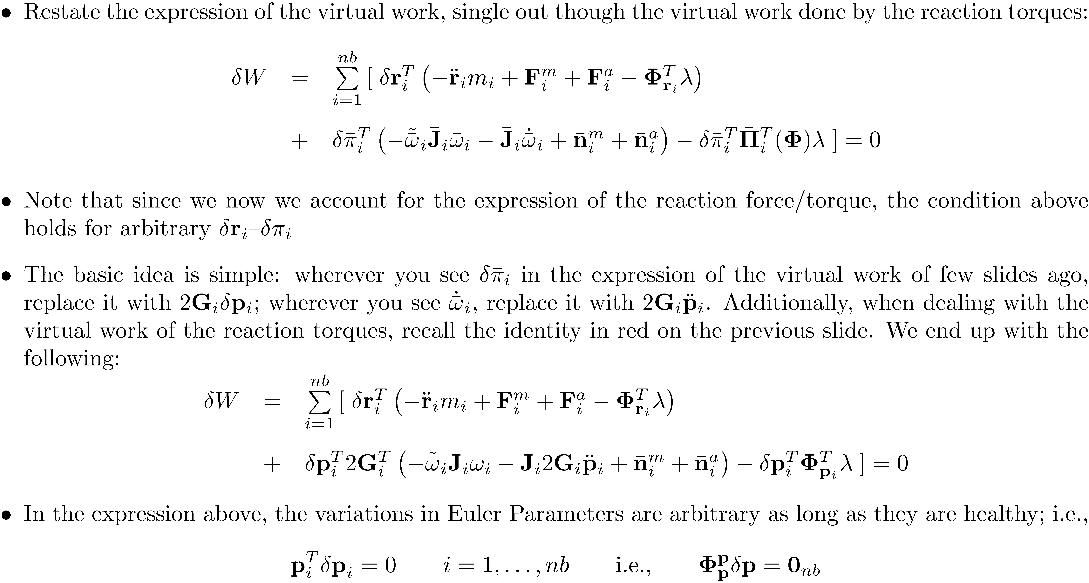
The r-p Formulation of the EOM: Revisiting the Expression of Virtual Work

Slide 12
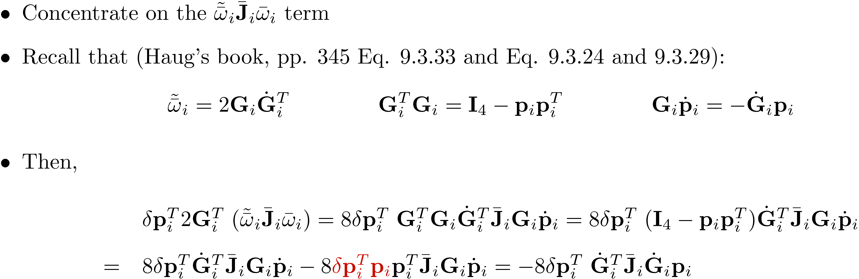
The r-p Formulation of the EOM: Taking care of some details

Slide 13
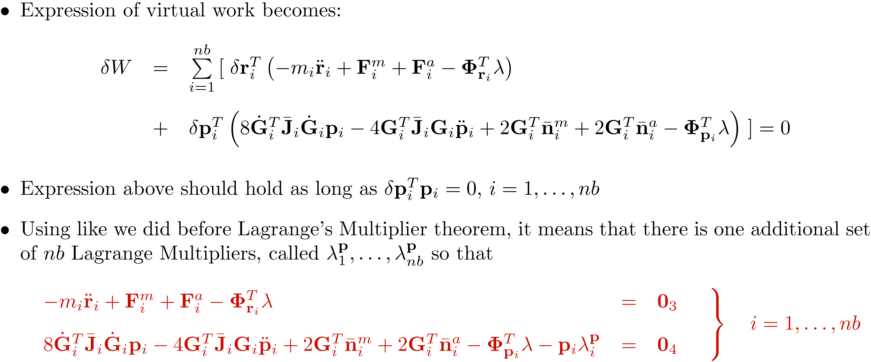
The r-p Formulation of the EOM: The Matrix-Free Form

Slide 14
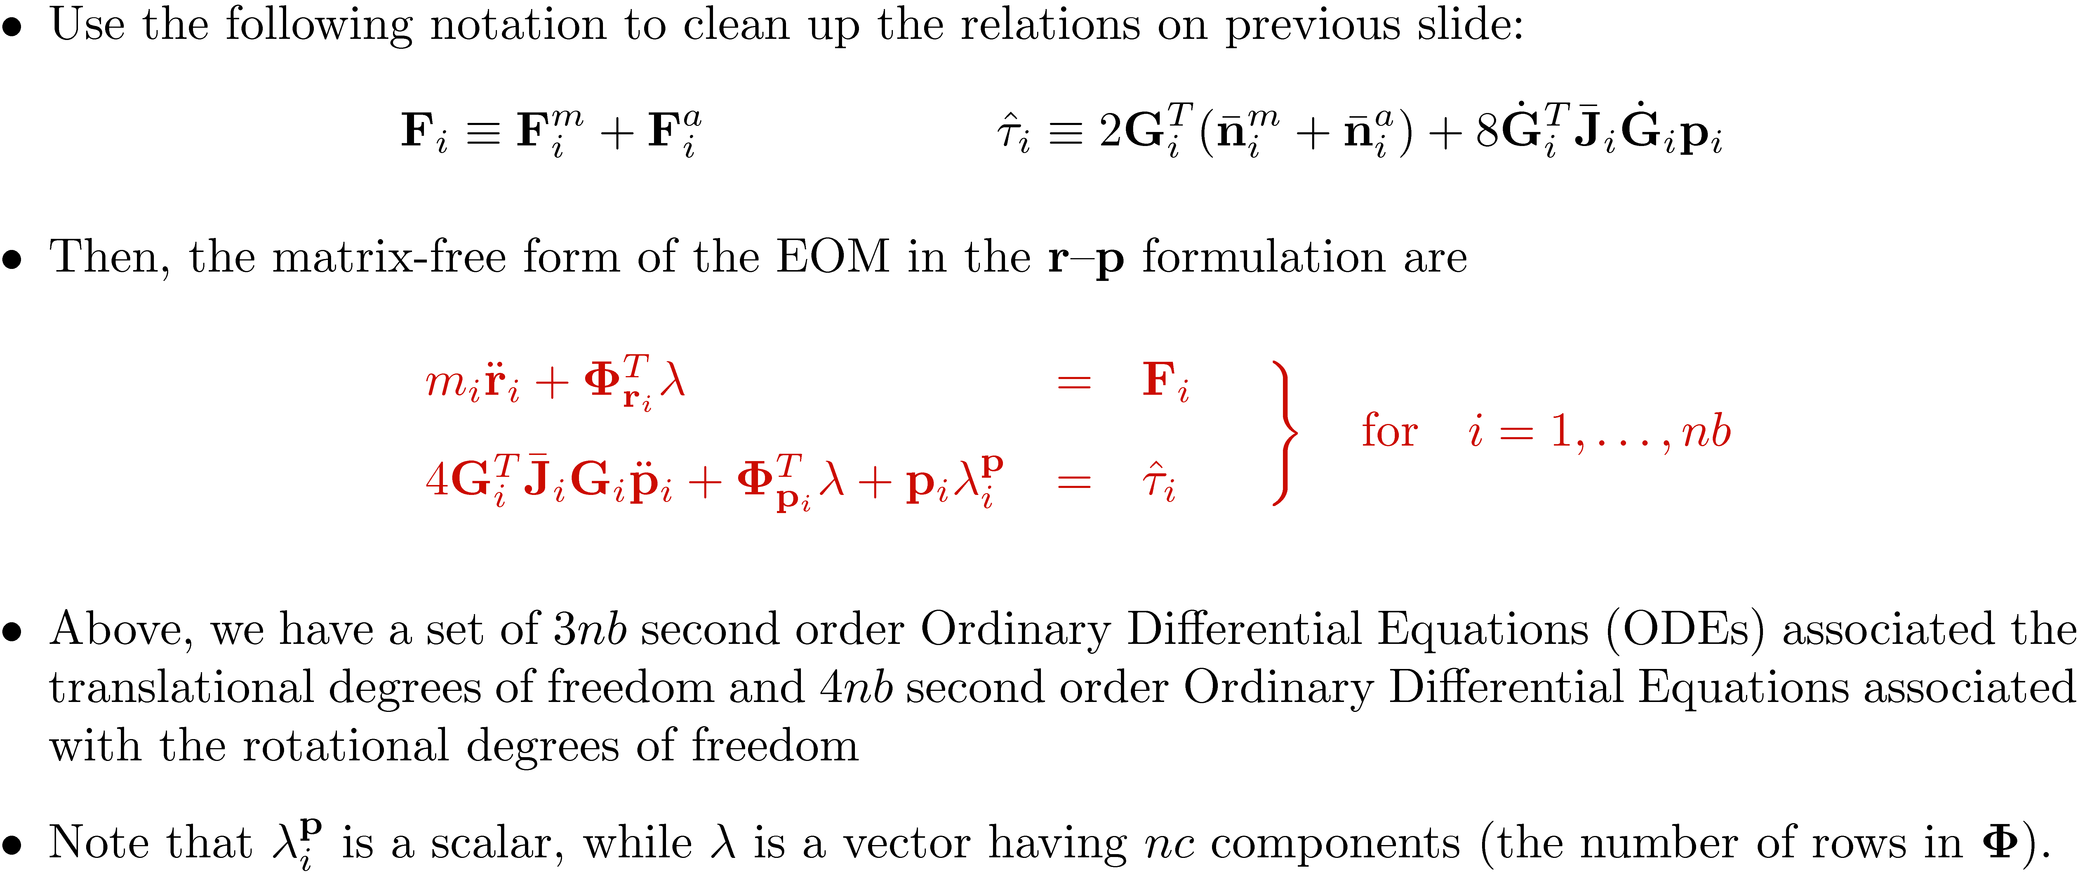
The r-p Formulation of the EOM: Matrix-Free Form, Tidying Up

Slide 15
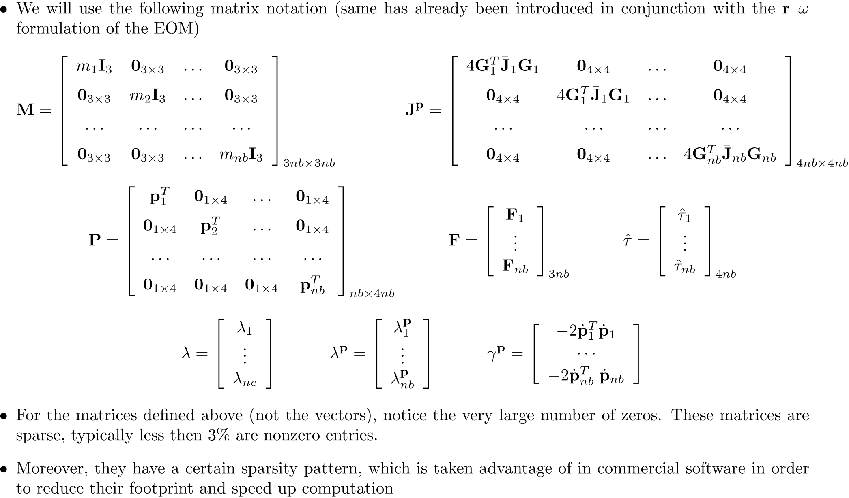
The r-p Formulation of the EOM: Ground Work for the Matrix Form of EOM

Slide 16
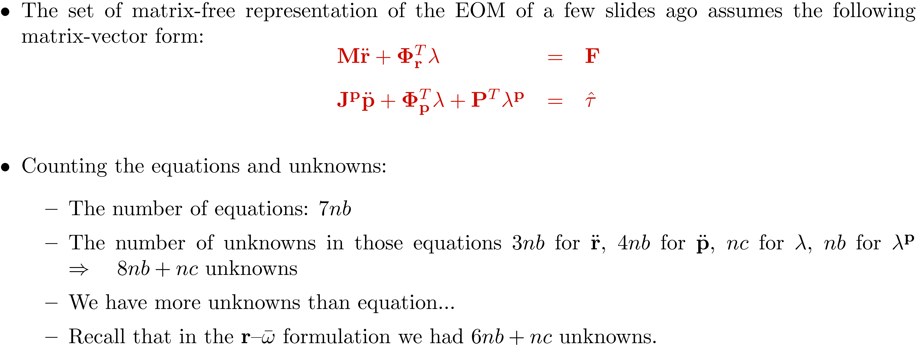
The r-p Formulation of the EOM: Matrix Form of the EOM, r-p Formulation

Slide 17
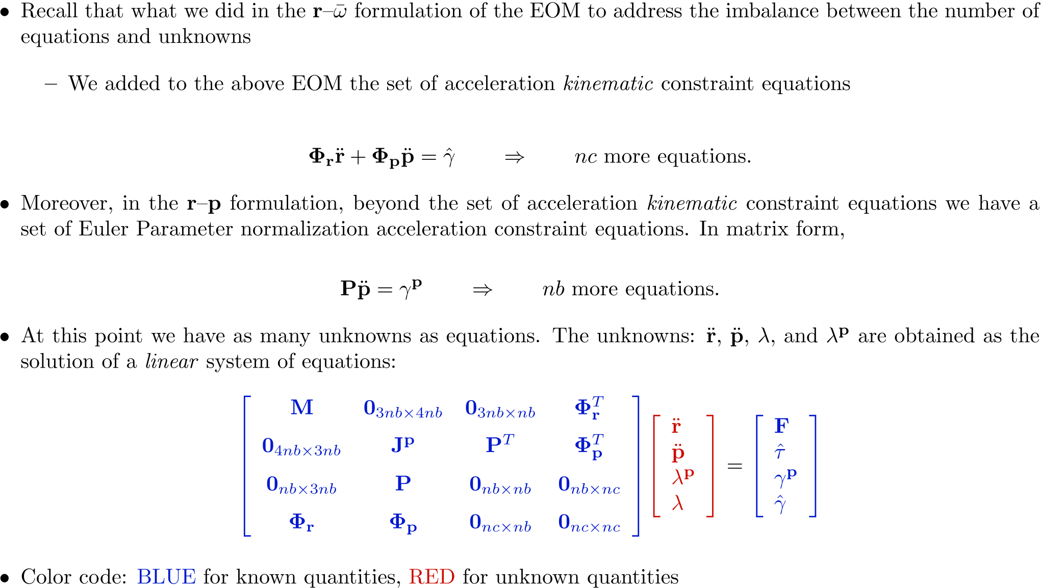
The r-p Formulation of the EOM: The Linear System for Acceleration and Lagr. Mult.

Slide 18
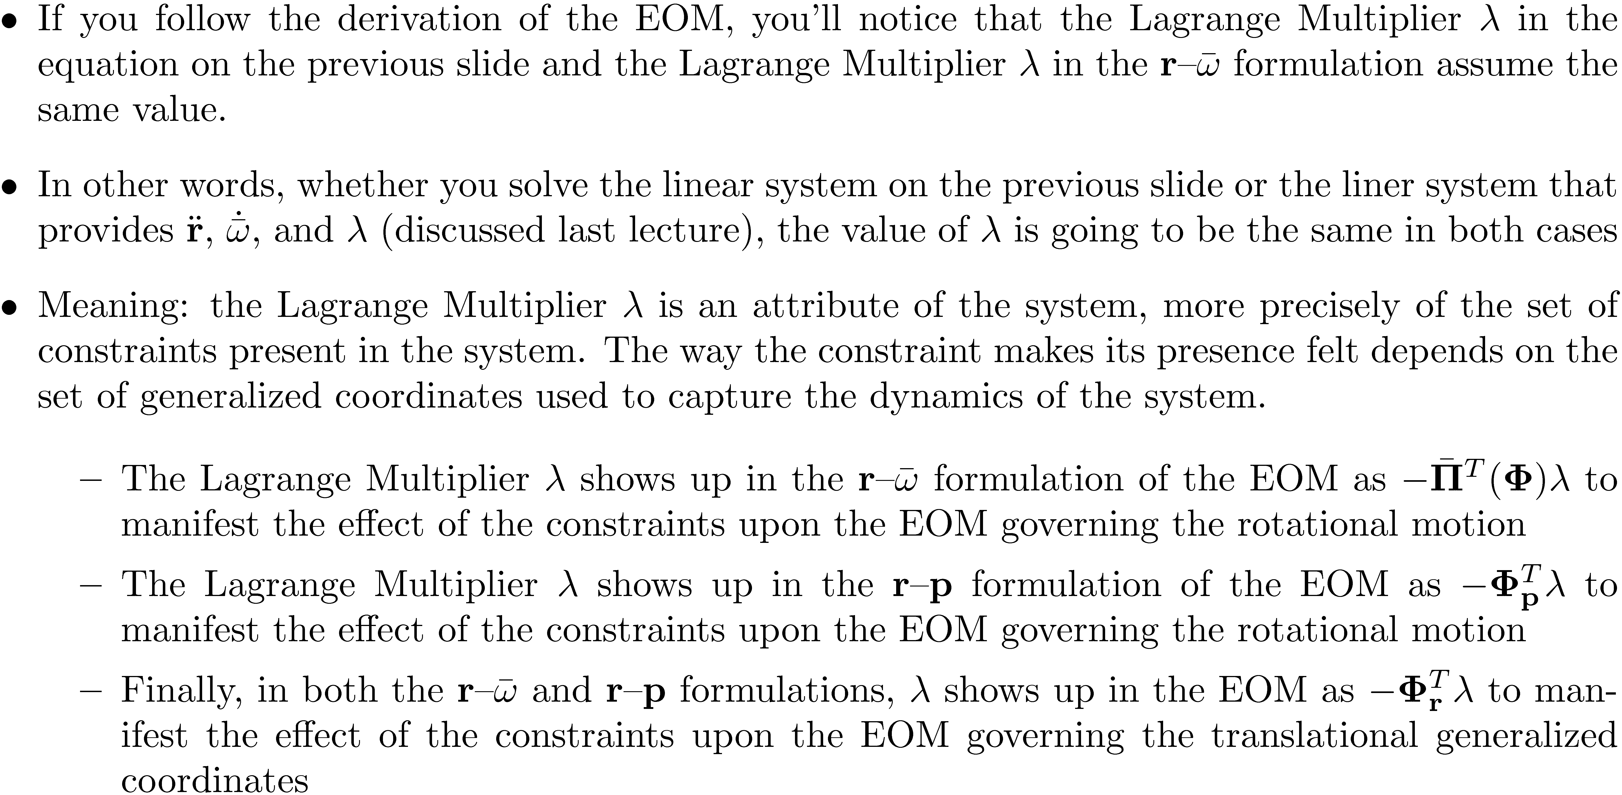
The r-p Formulation of the EOM: Quick Remarks

Slide 19
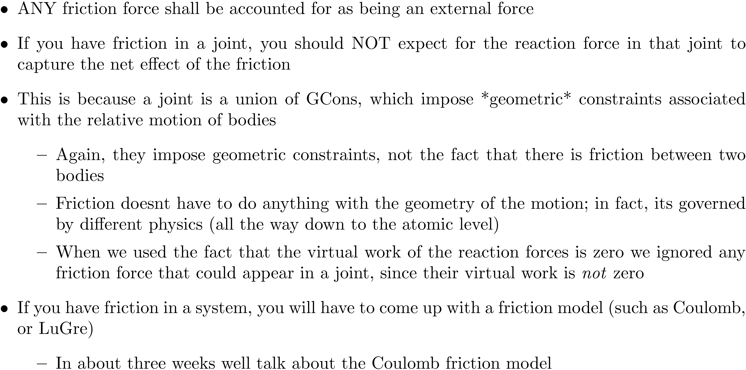
Comment: On the Handling of Friction Forces

Slide 20
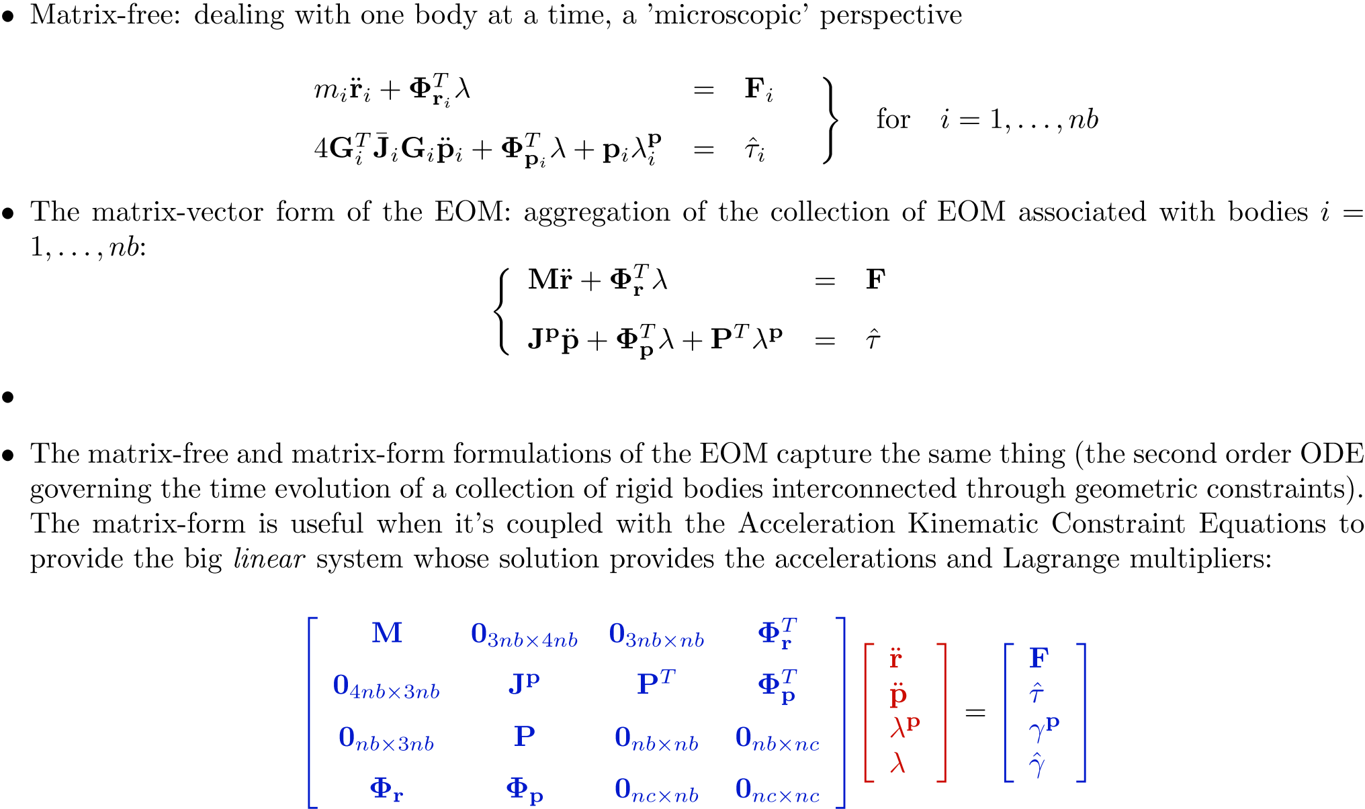
Comment: on the Matrix-Free and Matrix-Form of the EOM

Slide 21
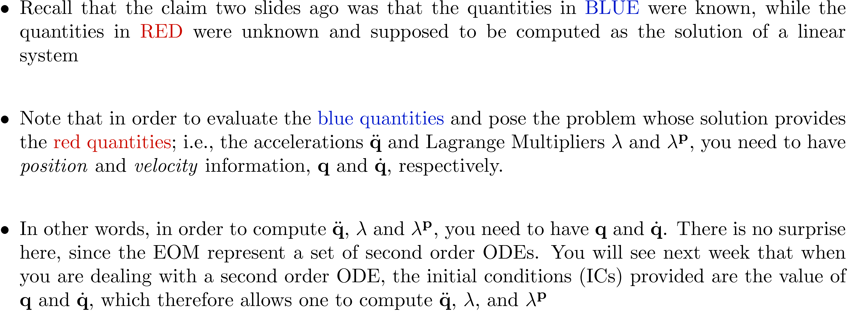
The r-p Formulation of the EOM: Providing Initial Conditions

Slide 22
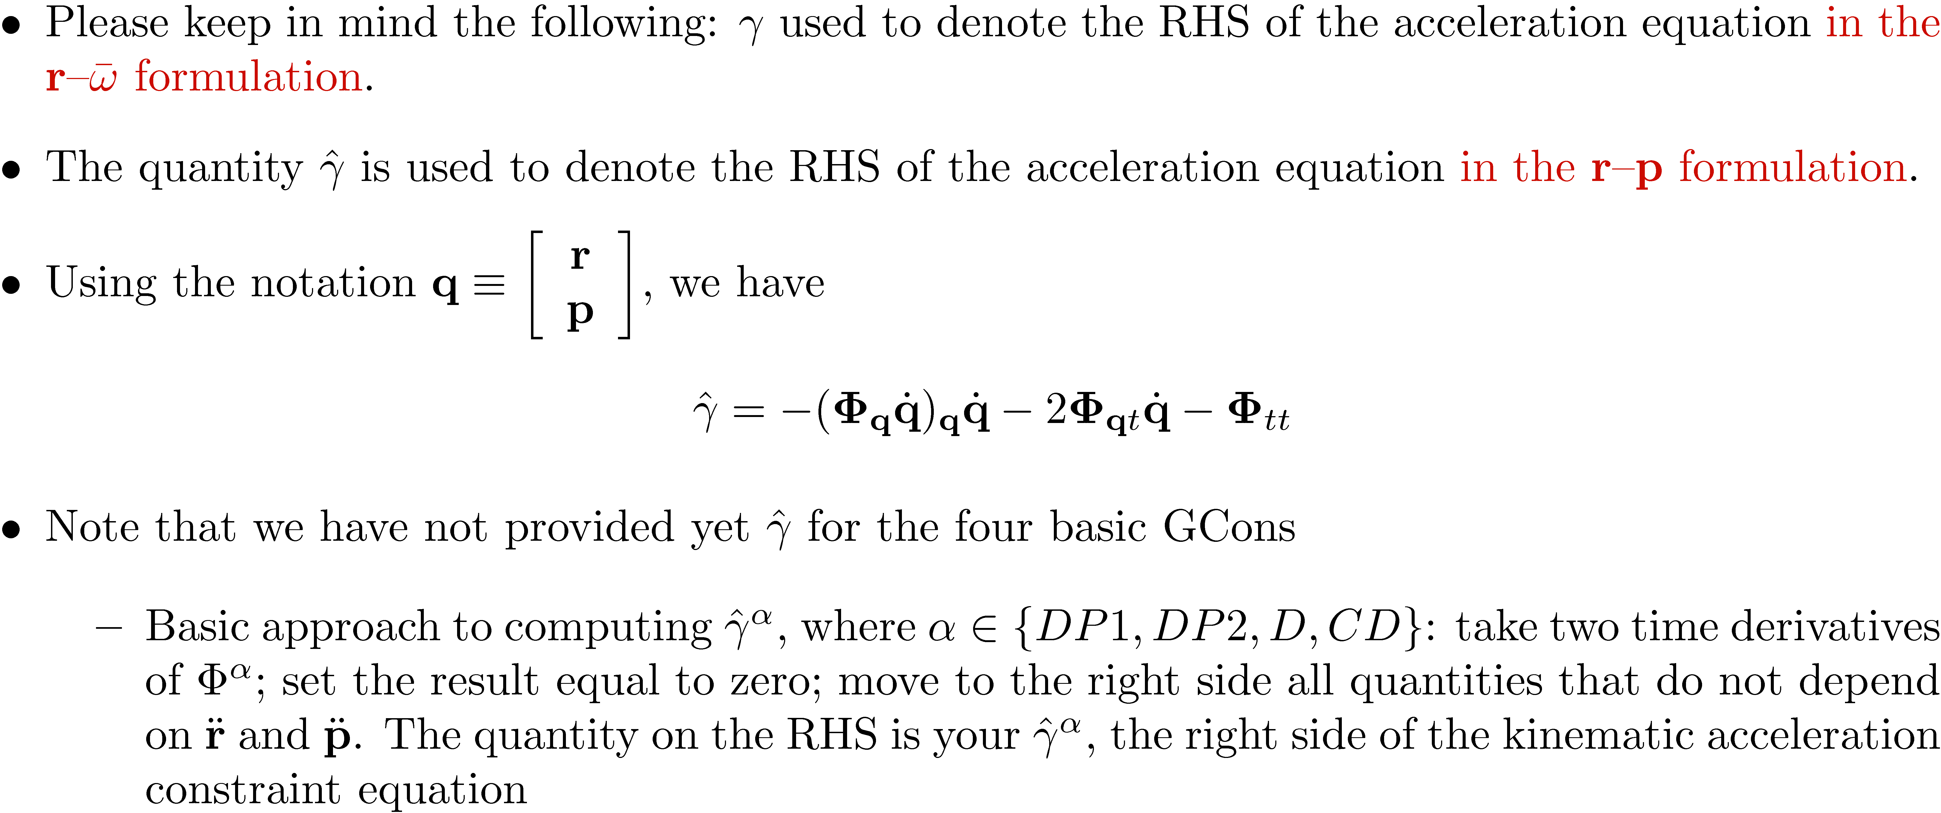
The r-p Formulation of the EOM: The RHS of the Acceleration Kin. Constr. Eq.

Slide 23
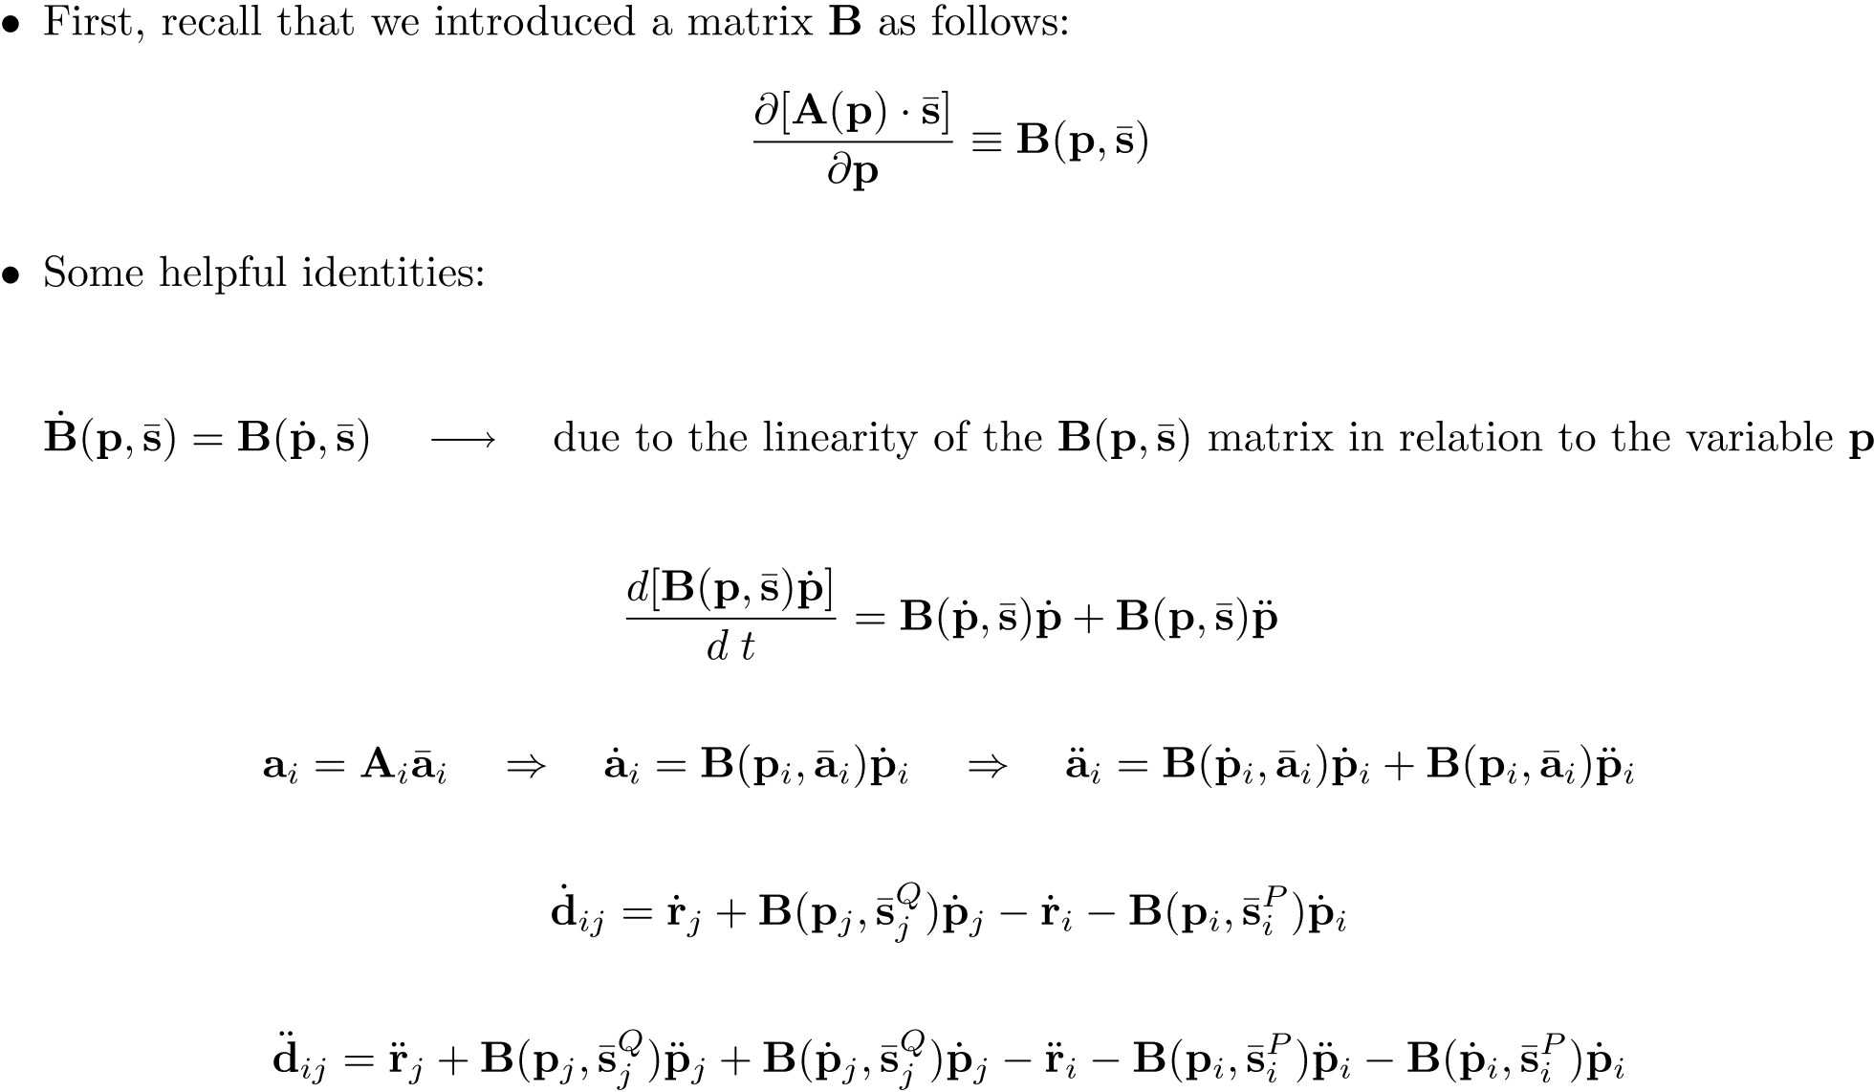
The r-p Formulation of the EOM: Getting the RHS of the Acceleration Equation

Slide 24
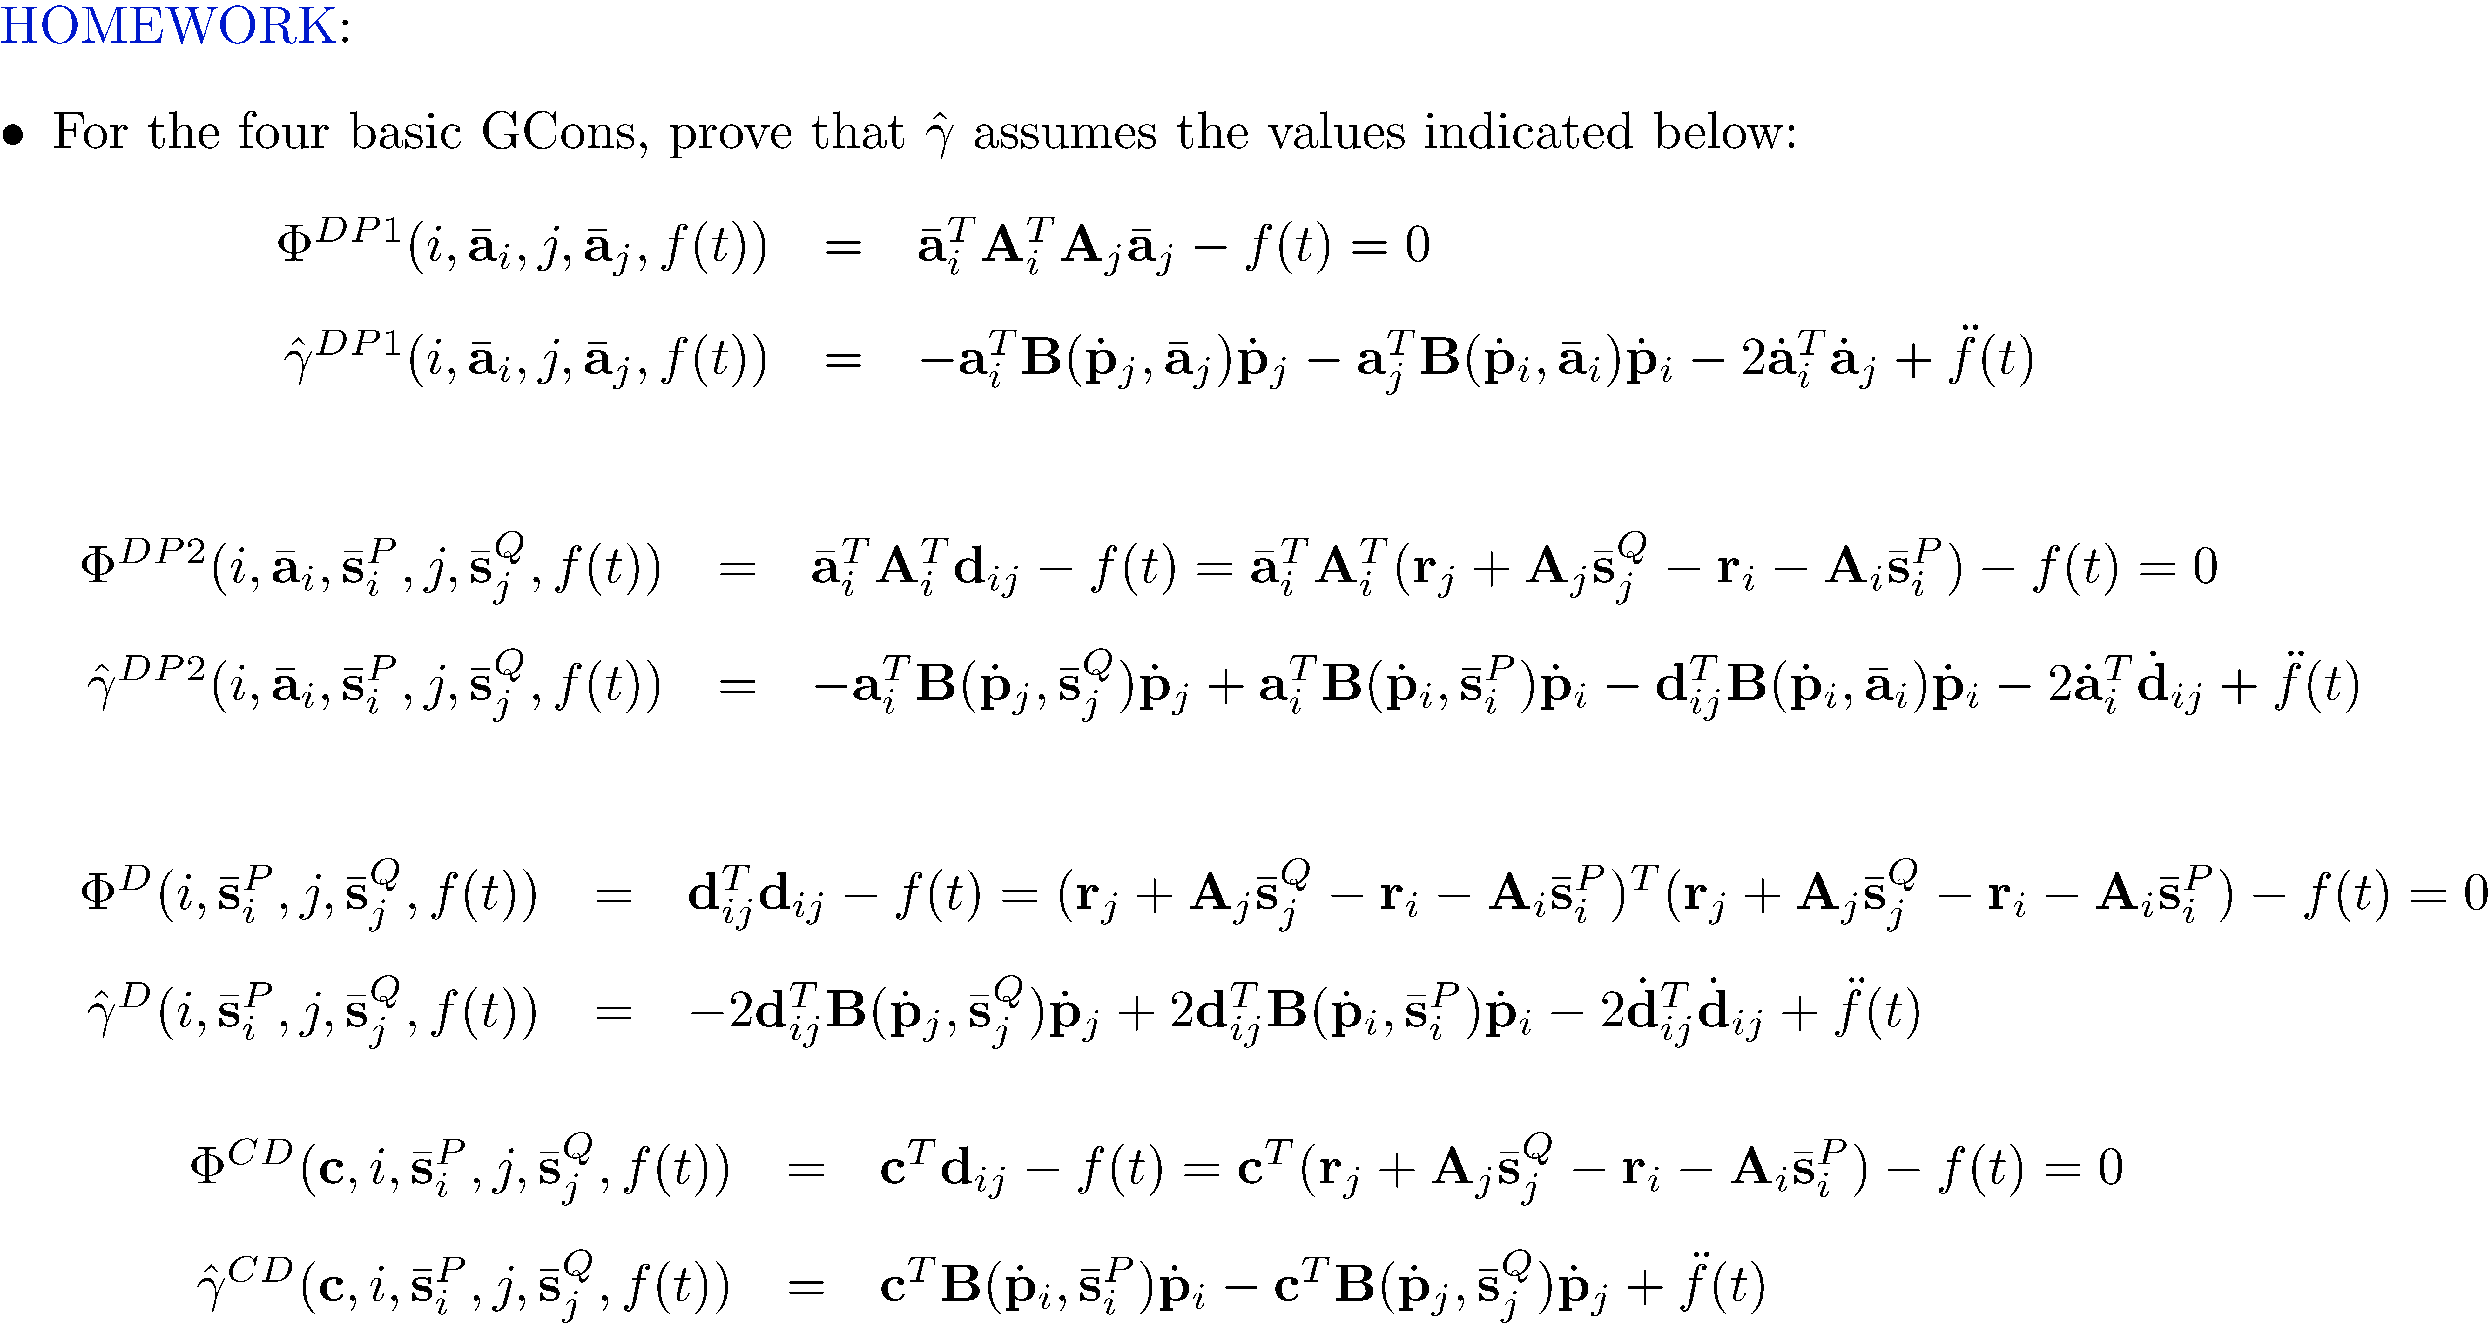
The r-p Formulation of the EOM: Getting the RHS of the Acceleration Equation

